Slide 1
MODULE 5
INFORMATION RETRIEVAL AND LEXICAL RESOURCES

Slide 2
Introduction
Information retrieval (IR) deals with the organization, storage, retrieval and evaluation of information relevant to a user’s query.
The user in need of information formulates a request in the form of a query written in a natural language.
The retrieval system responds by retrieving the document that seems relevant to the query.
IR systems doesn’t return the actual information, it returns the documents containing that information.
An information retrieval system does not inform the user on the subject of the query. Rather, it merely informs on the existence and whereabouts of documents relating to the query.
The IR system differs from question answering system and data retrieval system. The three systems differ in the nature of their queries and expected results of the queries.
In both question answering system and data retrieval systems, queries are very specific and precise in nature. Queries submitted to IR systems are often vague and imprecise.
A question answering system provides users with answers to specific questions.
Data retrieval systems retrieve precise data, usually organized in a well defined structure. Unlike DR system, IR system do not search for specific data nor do they search for direct answers to questions as QA systems do.

Slide 3
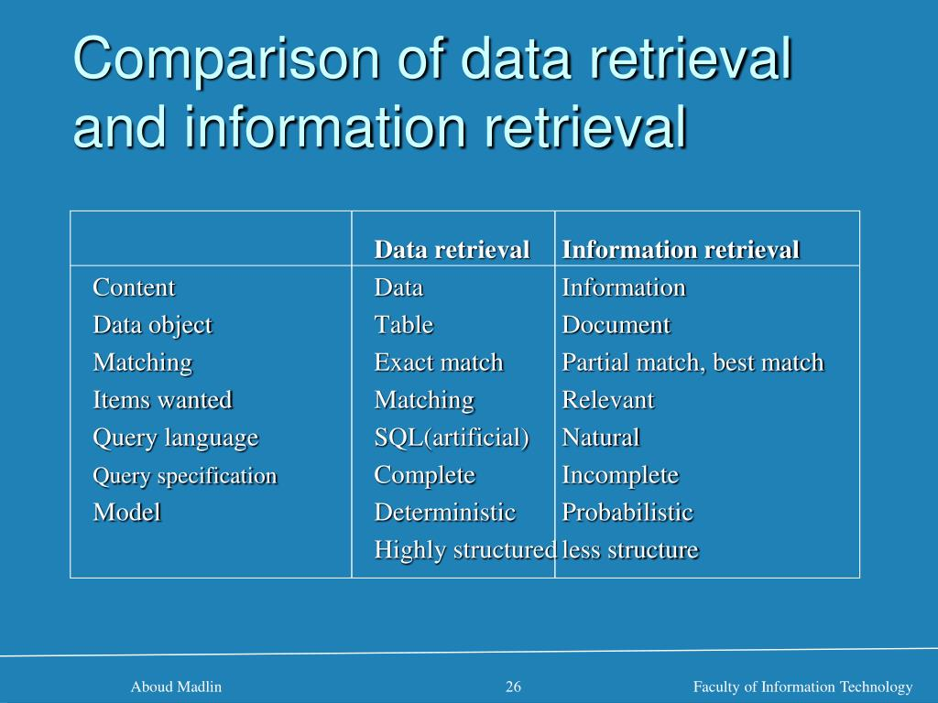
Introduction

Slide 4
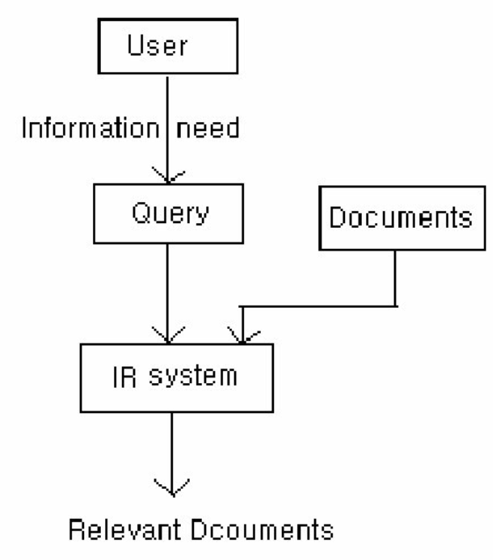
Design Features of Information Retrieval Systems
Give Design feature of IR system. (6 M, Jan 2019)
Explain design feature of IR systems with a neat diagram (10 M, Feb 2021)
The process of IR begins with the user’s information need.
Based on the need the user formulates a query.
The IR system returns documents that seem relevant to the query.
The retrieval is performed by matching the query representation with document representation.
The actual text of the document is not used in the retrieval process. Instead documents in a collection are frequently represented through a set of index terms or keywords.

Slide 5
Design Features of Information Retrieval Systems
Representation of documents as a set of index terms or keywords provides a logical view of the document.
The process of transforming document text to some representation of it is known as indexing.
There are different types of index structures. The one commonly used is inverted index.
An inverted index is a list of keywords, with each keyword carrying pointers to the documents containing that keywords.
Note:
  A forward index (or just index) is the list of documents, and which words appear in them.
  The inverted index is the list of words, and the documents in which they appear.
  They are both indexes - it's just a question of which direction you're going.
  Forward is from documents->to->words, inverted is from words->to->documents.

Slide 6
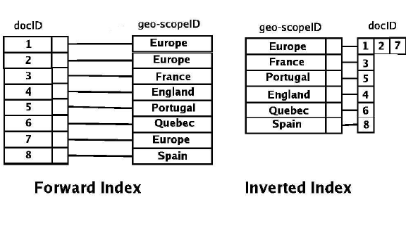
Design Features of Information Retrieval Systems

Slide 7
Design Features of Information Retrieval Systems
The computational cost involved in adopting a full text logical view, i.e., using a full set of words to represent a document is high. Hence, some text operations are performed to reduce the set of representative keywords.
The two most commonly used text operations are stop word elimination and stemming.
Stop word elimination removes grammatical or functional words.
Stemming reduces words to their common grammatical roots.
Zipf’s law is applied to further reduce the size of index set.
All terms in a document will not be equally relevant. Few might be more important in conveying a document’s content.
We quantify the significance of index terms to a document by assigning them numerical values called weights.
A number of term-weighting schemes are available.

Slide 8
Indexing
Define indexing. List and explain methods used to reduce the set of representative keywords during indexing. (10 Marks, June/July 2019)
In a small collection of documents, an IR system can access a document to decide its relevance to a query. However, in a large collection of documents, the same technique poses practical problems. Hence a collection of raw documents is usually transformed into an easily accessible representation. This process of transforming a collection of raw documents into an easily accessible representation is known as indexing.
Indexing technique involves identifying good document descriptors such as keywords or terms, which help in describing the content of the document and as well as discriminating it from other documents in the collection.
Luhn, proposed that the discrimination power of index terms is a function of the rank order of the frequency of their occurrence and that middle frequency terms have the highest discrimination power. This model was proposed for the extraction of salient terms from a document. These extracted terms are then used to represent text.
Hence indexing is simply the representation of text (both query and document) as a set of terms whose meaning is equivalent to some content of the original text.

Slide 9
Indexing
The word term can be a single word or multi-word phrases. For example, the sentence, Design features of information retrieval systems, can be represented as -
Design, features, information, retrieval, systems
It can also be represented by the set of terms:
Design, features, information retrieval, information retrieval systems
Multi-word terms are obtained by looking at frequently appearing sequences of words, n-grams, part-of-speech tags, or by applying NLP to identify meaningful phrases.
POS tagging helps to extract meaningful sequences of words, it handles sense ambiguity as words are assigned POS based on their local or sentential context

Slide 10
Indexing
In text retrieval conference (TREC), the method used for phrase extraction is -
Any pair of adjacent non-stop words is regarded a potential phrase.
The final list of phrases is composed of those pairs of words that occur in, say, 25 or more documents in the document collection.
The NLP is also used in the recognition of proper nouns and the normalization of noun phrases.
Phrase normalization captures structural variations in phrases. For example, the three phrases, text categorization, categorization of text, and categorize text are normalized to give text categorize.

Slide 11
Eliminating Stop Words
Stop word elimination may be harmful - justify (Jan 2020, 4 Marks)
Explain the benefits of eliminating stop words. Give examples in which stop word elimination may be harmful. (4 M, Feb 2021)
The lexical processing of index terms involves elimination of stop words.
Stop words are high frequency words which have little semantic weight and are thus, unlikely to help in retrieval.
Stop words play important grammatical role in language but do not contribute to the semantic content of a document in a keyword based representation. Such words are commonly used in documents regardless of topics and thus, have no typical specificity.
Typical example of stop words are articles and prepositions. Eliminating them considerably reduces the number of index terms.

Slide 12
Advantages and Disadvantages of Eliminating Stop words
Advantages:
Eliminating stop words can result in considerable reduction in number of index terms without losing any significant information.
Disadvantages:
The drawback of eliminating stop words is that it can sometimes result in elimination of useful index terms.
For example, the stop word ‘A’ in Vitamin A.
Some phrases like ‘to be or not to be’ consist entirely of stop words. Eliminating stop words in this case makes it impossible to correctly search a document.

Slide 13
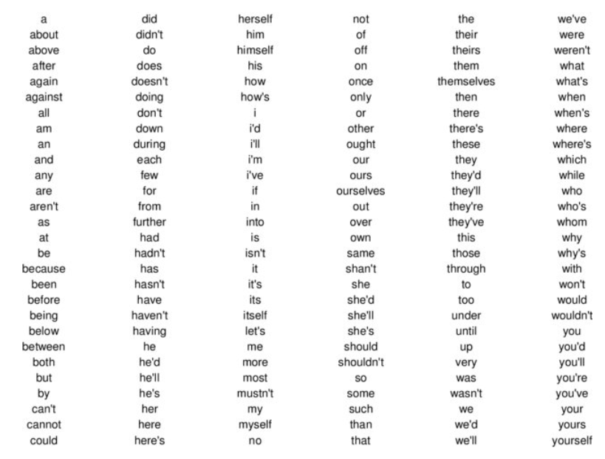
Sample Stop Words in English

Slide 14
Stemming
How stemming affects the performance of IR system? (4M Jan 2020)
Stemming normalizes morphological variants by removing affixes from the words to reduce them to their stem.
Example The words compute, computing, computes and computer will be reduced to it stem comput.
Hence, the keywords or terms used to represent text are stems and not the actual words.
The stemmed representation of the text -
‘Design features of information retrieval systems’ is
{design, featur, inform, retriev, system}
The stop words have been removed and the remaining terms are in lower case.

Slide 15
Advantages and Disadvantages of Stemming
Advantages:
Stemming is useful to help combine similar terms resulting in increased recall.
Eg., The words compute, computing, computers and computer will be reduced to its stem comput.
Disadvantages:
Stemming may throw away useful distinctions.
In some cases it may be resulting in reduced precision. Eg., when documents containing the term computation are returned in response to the query phrase ‘personal computer’.

Slide 16
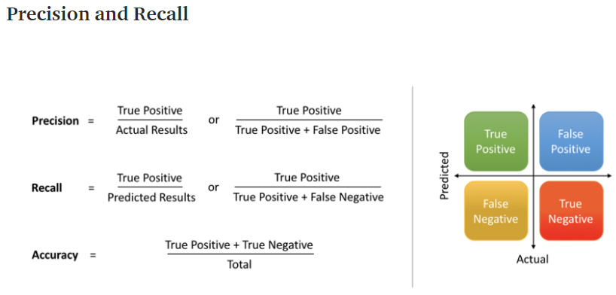
Precision and Recall
https://www.youtube.com/watch?v=ZpiJNez28fY&list=RDCMUCIZ3CSNL-8mBHfFZLic1-aQ&index=5

Slide 17
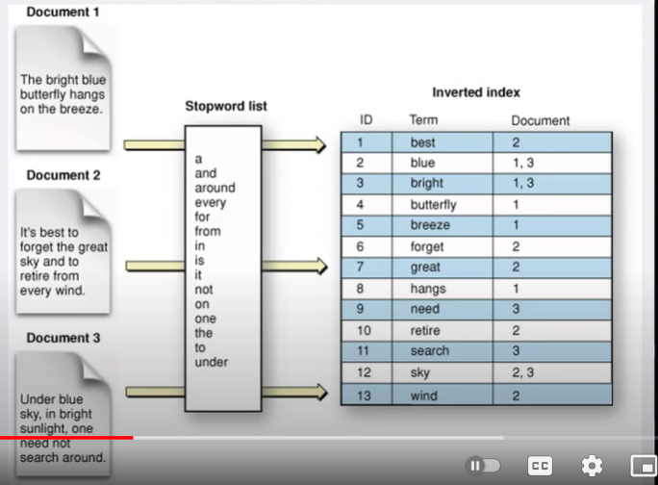
IR System

Slide 18
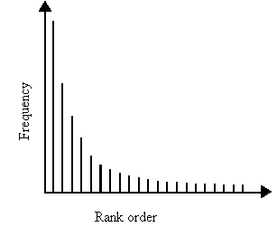
Zipf’s Law
State and Explain Zip’s law (4 M, Feb 2021)
Zipf made an important observation on the distribution of words in natural languages. This observation has been named Zipf’s law.
Zipf’s law states that the frequency of words multiplied by their ranks in a large corpus is more or less constant.
  Frequency * rank ≈ constant
If we compute the frequencies of words in a corpus and arrange them in decreasing order of frequency, then the product of the frequency of a word and its rank is approximately equal to the product of, the frequency and rank of another word.
This indicates that frequency of the word is inversely proportional to its rank.

Slide 19
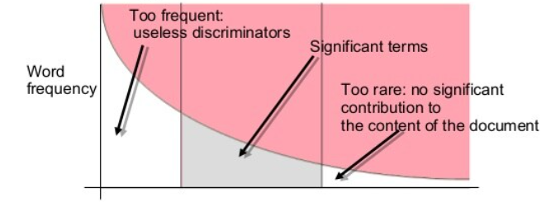
Application of Zipf’s Law in Stop Word Elimination
Empirical investigation of Zipf’s law on large corpuses suggest that human languages contain a small number of words that occur with high frequency and a large number of words that occur with low frequency.
In between is a middling number of medium frequency terms. This distribution has important significance in IR.
The high frequency words, being common, have less discriminating power and are not useful for indexing.
Low frequency words are less likely to be included in the query and are also not useful for indexing. As there are large number of low frequency words, dropping them considerably reduces the size of list of index terms.
The remaining medium frequency words are content-bearing terms and can be used for indexing.
This is implemented by defining thresholds for high and low frequency and dropping words that have frequencies above or below these thresholds.
Stop word elimination is an implementation of Zipf’s law, where high frequency terms are dropped from a set of index terms.

Slide 20
Information Retrieval Models
An IR model is a pattern that defines several aspects of retrieval procedure, for eg.,
  how documents and user’s queries are represented
  how a system retrieves relevant documents according to users’ queries
  how retrieved documents are ranked.
An IR system consists of
  a model of documents
  a model of queries
  a matching function which compares queries to documents.
The central objective of the model is to retrieve all documents relevant to the query.
IR models can be classified as:
Classical models of IR
Non-Classical models of IR
Alternative models of IR

Slide 21
Classical models of IR
Classical models of IR are based on mathematical knowledge that is easily recognized and well understood.
They are simple, efficient and easy to implement.
Almost all existing commercial systems are based on the mathematical models of IR. Hence the name classical models of IR.
The three classical IR models are:
Boolean model
Vector model
Probabilistic model

Slide 22
Non-classical Models of IR
Non-classical IR models perform retrieval based on principles other than those used by classical models, i.e., similarity, probability and Boolean operation.
These are best illustrated by models based on special logic technique, situation theory or the concept of interaction.
Non-classical IR models are -
Information logic model
Situation theory model
Interaction model.

Slide 23
Alternative Models of IR
Alternative IR models are enhancements of classical models making use of specific techniques from other fields.
Alternative IR models are -
Cluster model
Fuzzy model
Latent semantic indexing (LSI) model

Slide 24
Classical IR Models - Boolean Model
Explain Boolean and Vector space information retrieval model (10 M, Jan 2019)
With Example explain Boolean model for classical IR (6 M, Feb 2021)
Boolean model is the oldest of the three classical models. It is based on Boolean logic and classical set theory.
In this model documents are represented as a set of keywords, usually stored in an inverted file.
An inverted file is a list of keywords, and identifiers of the documents in which they occur.
Users are required to express their queries as a boolean expression consisting of keywords connected with boolean logical operators (AND, OR, NOT).
Retrieval is performed based on whether or not document contains the query terms.

Slide 25
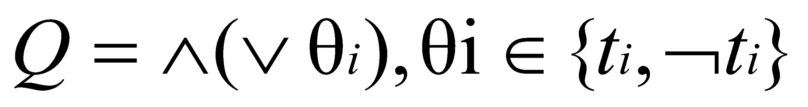
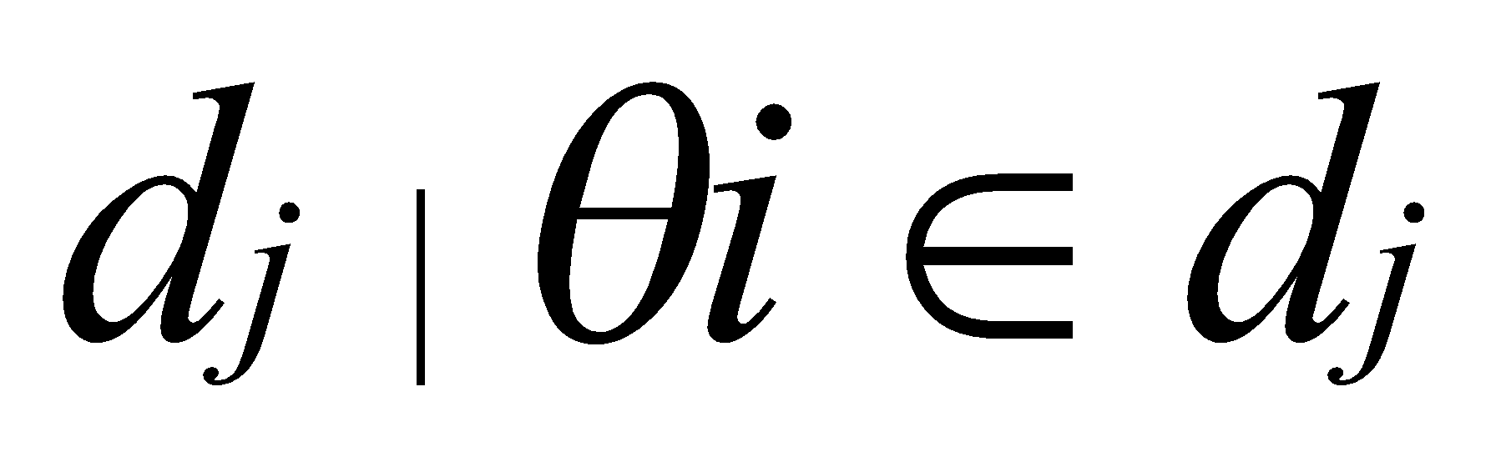
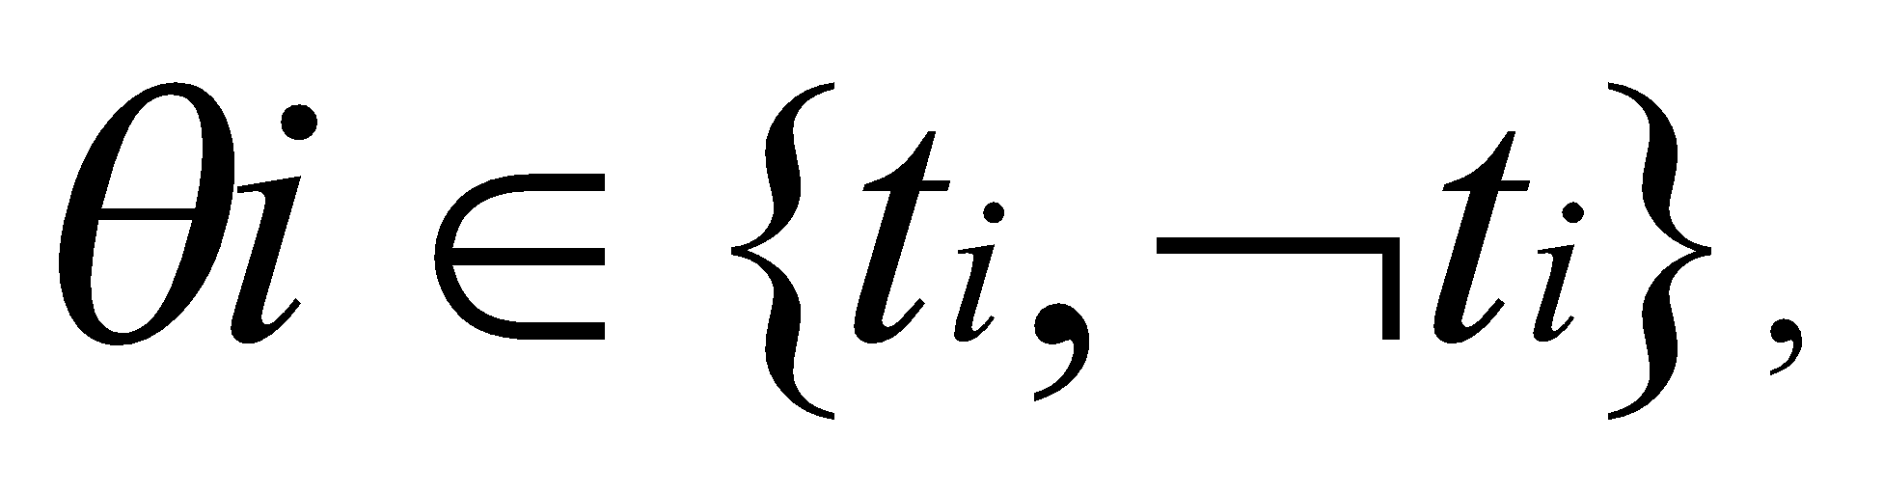
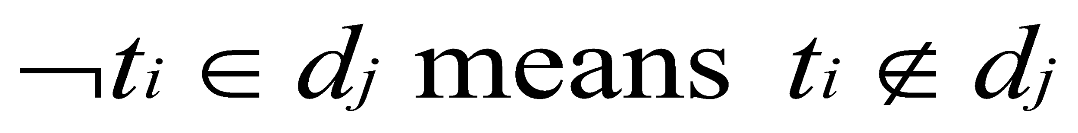
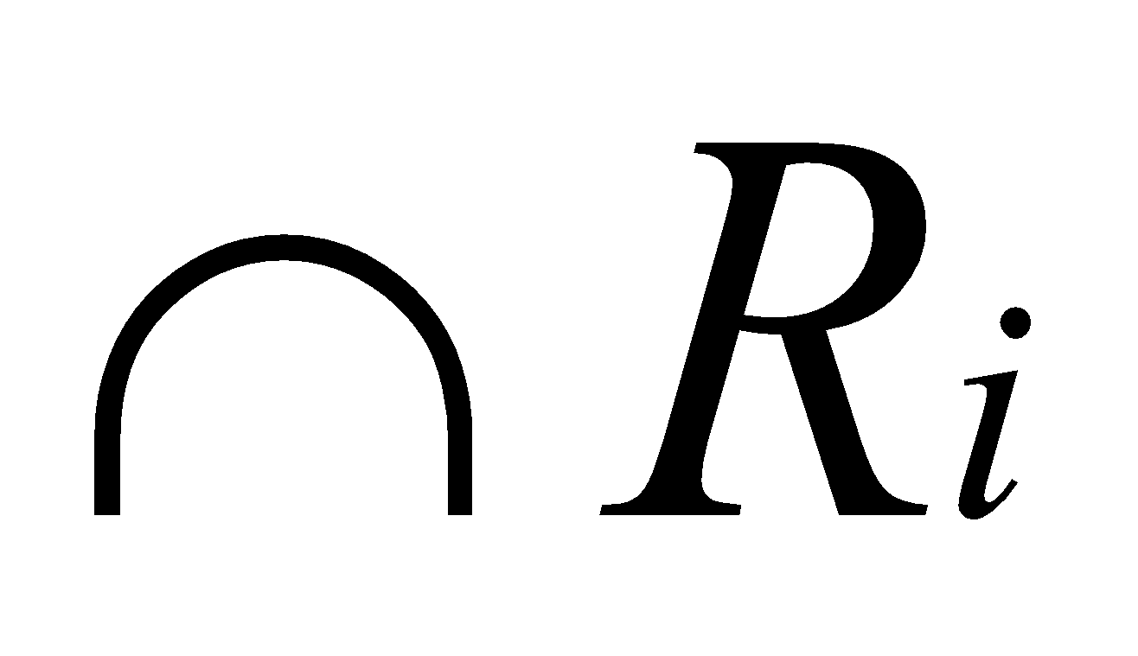
Boolean Model
Given a finite set
T = { t₁, t₂, ..., t_{i} , ...,t_{m} } of index terms,
a finite set
D = { d₁, d₂ , ...,d_{j} ,..., d_{n}} of documents and
a boolean expression - in a normal form - represent a query Q as follows:
The retrieval is performed in two steps:
The set R_{i} of documents are obtained that contain or do not contain the term t_{i}:
R_{i} = { },
Where
2. Set operations are used to retrieve documents in response to Q:

Slide 26
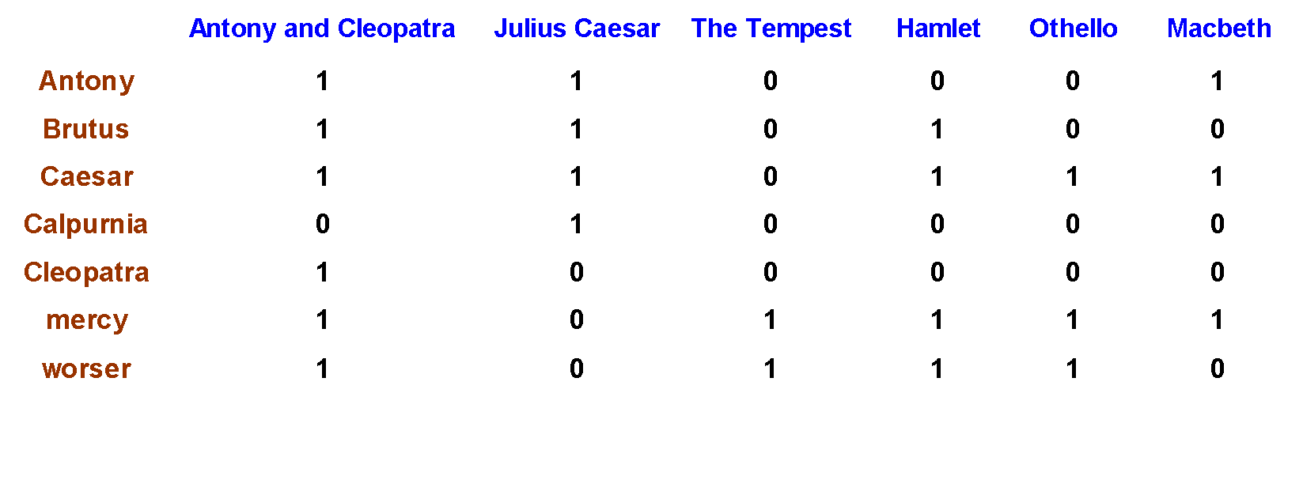
Boolean Model - Example 1:
Which plays of Shakespeare contain the words Brutus AND Caesar but NOT Calpurnia?
Document collection: A collection of Shakespeare's work.
So we have a 0/1 vector for each term.
To answer query: take the vectors for Brutus, Caesar and Calpurnia (complemented)
110100 AND 110111 AND 101111 = 100100
The plays Antony and cleopatra and Hamlet contain the words Brutus and Caesar but not Calpurnia.
Reference: https://www.youtube.com/watch?v=zRcwihu67H4
1 if play contains word, otherwise 0

Slide 27
Boolean Model - Example 2
Let the set of original documents be D={D1, D2, D3}
Where
D1 =Information retrieval is concerned with the organization, storage, retrieval and evaluation of information relevant to user’s query.
D2 = A user having an information needs to formulate a request in the form of query written in natural language.
D3 = The retrieval system responds by retrieving the document that seems relevant to the query.
Let the set of terms used to represent these documents be
T = { information, retrieval, query }
Then, the set D of document will be represented as follows:
D = { d1, d2, d3 }
Where
d1 = { information, retrieval, query }
d2 = { information, query }
d3 = { retrieval, query}
Let the Query Q be, Q = information ^ retrieval
Step 1: The sets R1 and R2 of documents are retrieved in response to Q, where
R1 = { dj | information ∈ dj } = { d1, d2 }
R2 = { dj | retrieval ∈ dj } = { d1, d3 }
Step 2: Then, the following documents are retrieved in response to the query Q
{ dj | dj ∈ R1 ⋂ R2 } = { d1 }
This results in the retrieval of the original document D1 that has the representation d1.

Slide 28
Boolean Model - Advantages and Disadvantages
Advantages:
Boolean IR models have been used in IR systems for a long time.
They are simple, efficient, easy to implement, perform well in terms of recall and precision if the query is well formulated.
Disadvantages:
The model fails to retrieve documents that are only partly relevant to user query, all information is ‘to be or not to be’.
Boolean system cannot rank the retrieved list of documents.
It distinguishes between presence and absence of keywords but fails to assign relevance and importance to keywords in a document.
User has to formulate the query in pure boolean expression.

Slide 29
Probabilistic model
Ranks the document based on the probability of their relevance to a given query.
Retrieval depends on whether probability of relevance (relative to a query) of a document is higher than that of non relevance, that is, whether it exceeds a threshold value.
Given a set of documents D, a query ‘q’, and a cut off value ‘α’ , this model first calculates the probability of relevance and irrelevance of a document to the query.
It then ranks documents having probability of relevance at least that of irrelevance in decreasing order of their relevance.
Documents are retrieved if the probability of relevance in the ranked list exceeds the cut off value.
If P( R / d ) is the probability of relevance of a document d, for query q, P( I / d ) is the probability of irrelevance. Then the set of the documents retrieved is:
S ={ d_{j} | P ( R / d_{j} ) >= P( I / d_{j} ) } , P ( R / d_{j} ) > α

Slide 30
Probabilistic Model - Advantages and Disadvantages
Advantages:
The probabilistic model produce results that partly match the user query.
Disadvantages:
Drawback is the determination of threshold value for the initially retrieved set, the number of relevant documents by a query is usually too small for the probability to be estimated accurately.
It assumes that the terms are independent when estimating probabilities. This assumption allows for accurate estimation of parameter values and helps reduce computational complexity of the model. However, this assumption seems to be inaccurate as terms in a given domain usually tend to co-occur. For eg., it is more likely that ‘match point’ will co-occur with ‘tennis’ rather than ‘cricket’.

Slide 31
Vector space model
The vector space model is one of the most well studied retrieval models.
Vector space model represents documents and queries as vectors of features representing terms that occur within them. Each document is characterized by a numerical vector.
These Vectors are represented in multidimensional space, in which each dimension corresponds to a distinct term in the corpus of documents.
Each feature takes a value of either zero or one, indicating the absence or presence of that term in a document or query.
Features are assigned numerical values that are usually a function of the frequency of terms.
Ranking algorithms compute the similarity between document and query vectors, to yield a retrieval score to each document.
This score is used to produce a ranked list of retrieval documents.

Slide 32
Vector space model
Given a finite set of n documents
D = { d₁, d₂, d₃, …, d_{n} }
and a finite set of m terms
T= { t₁, t₂, t₃, …, t_{m} }
each document is represented by a column vector of weights as follows
(w_{1j,} w_{2j,} w_{3j} ,…, W_{ij} ,..., w_{mj} )^{t}
Where W_{ij} is the weight of the term t_{i} in document d_{j}.
The document collection as a whole is represented by a m x n term - document matrix -
Term space
w₁₁ w₁₂ … w_{1j} … w_{1n}
w₂₁ w₂₂ … w_{2j} … w_{2n}
w₃₁ w₃₂ … w_{3j} … w_{3n}
w_{m1} w_{m2} … w_{mj} … w_{mn}
Document space

Slide 33

Example:
D1 = Information retrieval is concerned with the organization, storage, retrieval and evaluation of information relevant to user’s query.
D2 = A user having an information needs to formulate a request in the form of query written in natural languages.
D3 = The retrieval system responds by retrieving the document that seems relevant to the query.
T = { information, retrieval, query }
Let the weights be assigned based on the frequency of the term in the document. Then the associated vectors will be as shown in matrix 1.
Convert document vectors to unit length by dividing elements of each column by the length of the column vector given by √Σ_{i}w_{ij}²
Term Document Matrix
 | t1 | t2 | t3
d1 | 2 | 2 | 1
d2 | 1 | 0 | 1
d3 | 0 | 1 | 1
 | d1 | d2 | d3
t1 | 2 | 1 | 0
t2 | 2 | 0 | 1
t3 | 1 | 1 | 1
 | d1 | d2 | d3
t1 | 0.67 | 0.71 | 0
t2 | 0.67 | 0 | 0.71
t3 | 0.33 | 0.71 | 0.71
After Normalization ->

Slide 34
Term Weighting
Define Term Weighting. (Feb 2021)
Each term that is selected as an indexing feature for a document, acts as a discriminator between that document and all other documents in the corpus.
Term weighting is the process to quantify the discriminating power of the terms by associating the frequency of their occurrence (term frequency) within a document.
The following facts must be taken into account:
The more a document contains a given word, the more that document is about a concept represented by that word.
The less a term occurs in particular document in a collection, the more discriminating that term is.

Slide 35
Term Weighting
The first factor indicates that terms that occur more frequently represent the document’s meaning more strongly than those occurring less frequently and hence must be given high weights. This weight is the raw frequency of the term in the document.
The second factor considers term distribution across the document collection. Terms occurring in a few documents are useful for distinguishing those documents from the rest of the collection. Similarly, terms that occur more frequently across the entire collection are less helpful while discriminating among documents. This requires a measure that favours terms appearing in fewer documents.
The fraction n / n_{i} - gives the measure that favours terms appearing in fewer documents, where
n - total number of documents in the collection
n_{i} - the number of documents in which the term i occurs
This measure assigns the lowest weight 1 to a term that appears in all documents and the highest weight of n to a term that occurs in only one document.
As the number of documents in any collection is usually large, the log of this measure is taken, which is called inverse document frequency (idf) term weight.
idf_{i} = log ( n / n_{i} )
If a term occurs in all documents in a collection, its idf is 0

Slide 36
Term Weighting
The combination of term frequency (tf) and inverse document frequency (idf) weights results in a family of tf x idf weight schemes having the general formula -
W_{ij} = tf_{ij} * log (n/n_{i})
According to the above scheme, the weight of the term t_{i} in document d_{j} is equal to the product of document frequency of the term (term frequency) and log of its inverse document frequency within the collection.
The tf x idf weighting scheme combines both the ‘local’ and ‘global’ statistics to assign term weight.
The tf component is a document specific statistic that measures the importance of the term within the document.
The idf is a global statistic that attempts to include distribution of the term across the document collection.

Slide 37
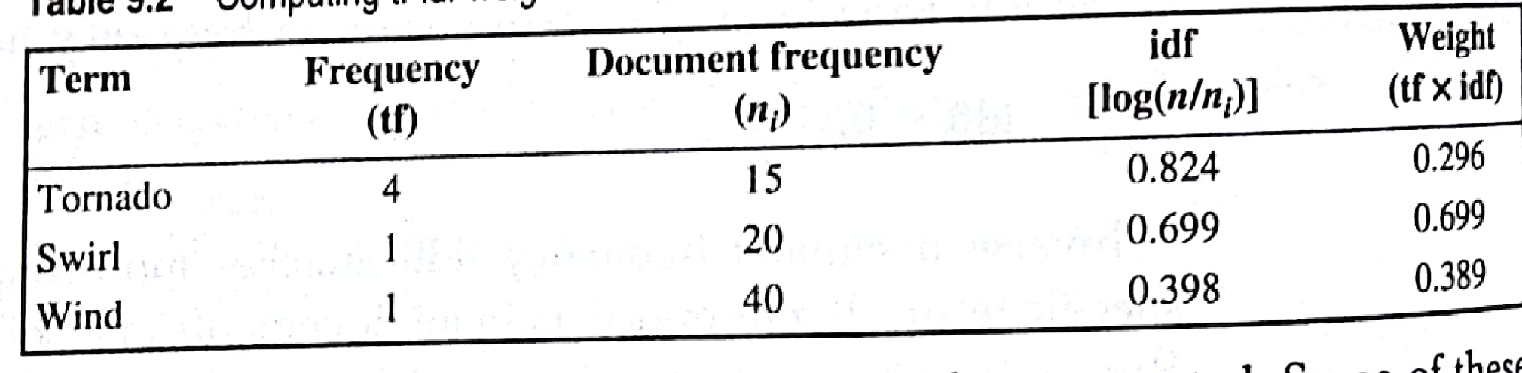
Term Weighting - Example
Example to explain how term weights can be calculated using the tf-idf weighting scheme.
Consider a document represented by three terms {tornado, swirl, wind} with the raw tf 4,1,1 respectively. In a collection of 100 documents, 15 documents contain the term tornado, 20 contain swirl and 40 contain wind. Find the idf and the term weight of the three terms. (6 M, Feb 2021)
idf - tornado -> log(n / ni) = log (100 / 15 ) = 0.824 Weight - tornado -> tf x idf = 4 * 0.824 = 3.296
idf - swirl -> log(n / ni) = log (100 / 20 ) = 0.699 Weight - tornado -> tf x idf = 1 * 0.699 = 0.699
idf - wind -> log(n / ni) = log (100 / 40 ) = 0.398 Weight - tornado -> tf x idf = 1 * 0.398 = 0.398
The following table shows the weights assigned to the three terms using tf x idf weighting scheme
3.296

Slide 38
Weighting Schemes
The three factors of weighting schemes are -
Within - document frequency or term frequence (tf)
Collection frequency or inverse document frequency (idf)
Document length - If a term appears the same number of times in a short document and in a long document, then the term appearing in short document is more valuable compared to the term appearing in long document.
Any term weighting schemes can be represented by a triple ABC.
A represents the way the tf component is handled.
B indicates the way the idf component is incorporated.
C represents the length normalization component.
Possible option for each of the three dimensions of the triple are shown in table.

Slide 39
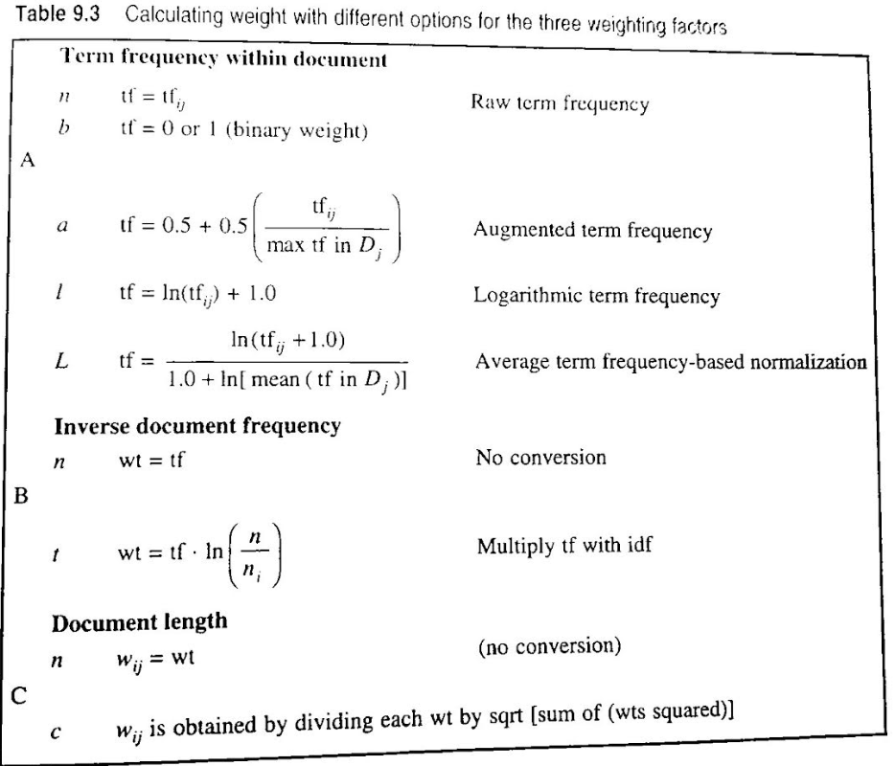
Weighting Schemes
Different combinations of options can be used to represent document and query vectors.
The retrieval model can be represented by a pair of triples like nnn.nnn (doc = ‘nnn’, query = ‘nnn’).
The first triple corresponds to the weighting strategy used for the documents and the second triple to the weighing strategy used for the query, for example, ntc-ntc, lnc-ltc, etc.

Slide 40
Simple automatic method for indexing
A simple auto method for obtaining indexed representation of the document is as follows -
Step 1: Tokenization:
This extracts individual term from the document, converts all the letters to lower case, and removes punctuation marks. The output of the first stage is a representation of the document as a stream of terms.
Step 2: Stop word elimination:
This removes the words that appear more frequently in the document.
Step 3: Stemming:
This reduces the remaining terms to their linguistic root, to obtain the index terms.
Step 4: Term weighting:
This assigns weight to terms according to their importance in the document, in the collection or some combination of both.

Slide 41
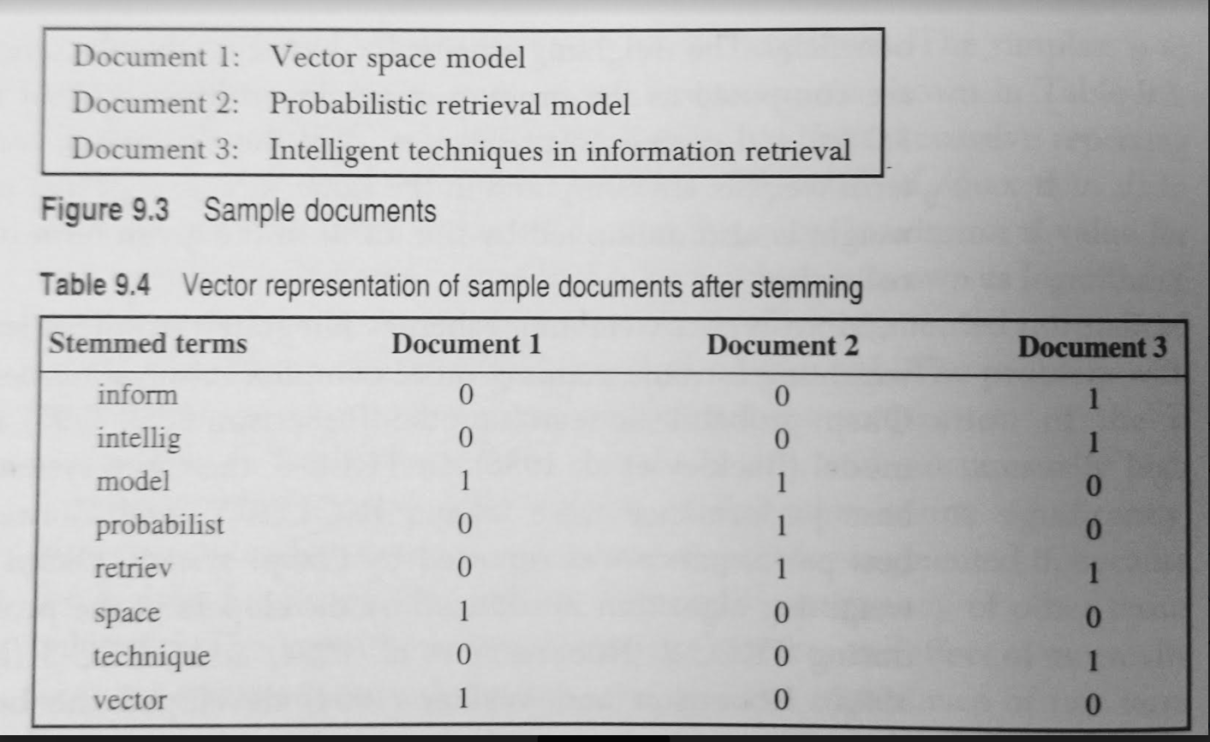
Simple automatic method for indexing
Table shows the document vectors obtained after the application of above steps on sample documents shown in fig. Below.

Slide 42
Non-classical models of IR
Non-classical IR models are based on principles other than similarity, probability, Boolean operations, etc., on which classical IR models are based.
Non-classical IR models are
Information logic model
situation theory model
interaction model.
Information Logic Model:
Information logic model is based on the special logic technique called logical imaging.
Retrieval is performed by making inferences from document to query.
Does not make use of any search process.
A measure of uncertainty is associated with this inferences.
The principle put forward by Van Rijsbergen is used to measure this uncertainty, which says that -
“Given any two sentences x and y , a measure of uncertainty of y->x relating to a given data set is determined by the minimal extent to which one has to add information to the data set in order to establish truth of y->x”
This model was developed in response to van Rijsbergen’s realization that classical models were unable to enhance effectiveness and that new meaning-based models were required.

Slide 43
Non-classical models of IR
2. Situation Theory Model
The Situation theory model is also based on Van Rijsbergen’s principle.
Retrieval is considered as a flow of information from document to query.
A structure called infon, denoted by τ (tau) is used to describe the situation and to model information flow.
An infon represents a n-ary relation and its polarity.
The polarity of an infon is either 0 or 1, indicating infon carries either positive or negative information.
For example, the Information in the sentence - ‘Adil is serving a dish’, is conveyed by the infon
τ = << Serving Adil, dish; 1 >>

Slide 44
Non-classical models of IR
Polarity of an infon depends on the support. The support of an infon is represented as s ⊨ τ, which means that the situation s makes the infon τ true.
For example, the infon, τ = << Serving Adil, dish; 1 >> is made true by a situation
s1 = “ I see Adil serving a dish”
A document d is relevant to a query q, if d ⊨ q (document supports the query)
If a document does not support the query, additional information such as synonyms, hypernyms / hyponyms, meronyms, etc., are used to transform the document d into d` such that d` ⊨ q.
Semantic relationships in the thesaurus, like WordNet, are useful sources for this information.
The transformation from d to d` is regarded as flow of information between situations.

Slide 45
Non-classical models of IR
3. Interaction model:
In interaction model documents are not isolated, instead they are interconnected.
The query interacts with the inter connected documents.
Retrieval is conceived as a result of this interaction.
Artificial neural networks can be used to implement this model.
Each document is modelled as a neuron, the document set as a whole forms a neural network.
The query is also modelled as a neuron and integrated into the network.
Because of this integration new connections are built between the query and the document and existing connections are changed.
This restructuring corresponds to the concept of interaction.
A measure of this interaction is obtained and used for retrieval.

Slide 46
Alternative Models of IR
Alternative IR models are enhancements of classical models making use of specific techniques from other fields.
Alternative IR models are -
Cluster model
Fuzzy model
Latent semantic indexing (LSI) model

Slide 47
Cluster Model
Explain the cluster and fuzzy models of IR system. (8M, Jan 2019)
With a suitable example explain cluster based IR modelling (8 M, July 2019)
The cluster model attempts to reduce the number of matches during retrieval.
The cluster hypothesis that explains why clustering could prove efficient in IR states that
“Closely associated documents tend to be relevant to the same clusters.”
The hypothesis suggests that closely associated documents are likely to be retrieved together.
By forming groups or classes or clusters of related documents, the search time reduces considerably.
Instead of matching a query with every document in the collection, it is matched with representatives of the cluster (class), and only documents from a class whose representative is close to query, are considered for individual match.
Clustering is applied on terms instead of documents. Terms can be grouped to form classes of co-occurrence terms.
A number of methods are used to group documents. One of the method is based on similarity matrix.

Slide 48
Cluster Model
Cluster Generation method based on Similarity Matrix
Let D = { d₁,d₂,d₃,…..d_{m} } be set of documents.
Let E = (e_{ij})_{n,n} be the similarity matrix.
The element E_{i,j} in this matrix, denotes a similarity between document d_{i} and d_{j}.
Let T be the threshold value.
Any pair of documents d_{i} and d_{j} (i != j) whose similarity measure exceeds threshold (e_{ij} >= T) is grouped to form a cluster.
The remaining documents form a single cluster.
The set of clusters thus obtained is
C = { C₁, C₂, …, C_{k}, …, C_{p} }

Slide 49
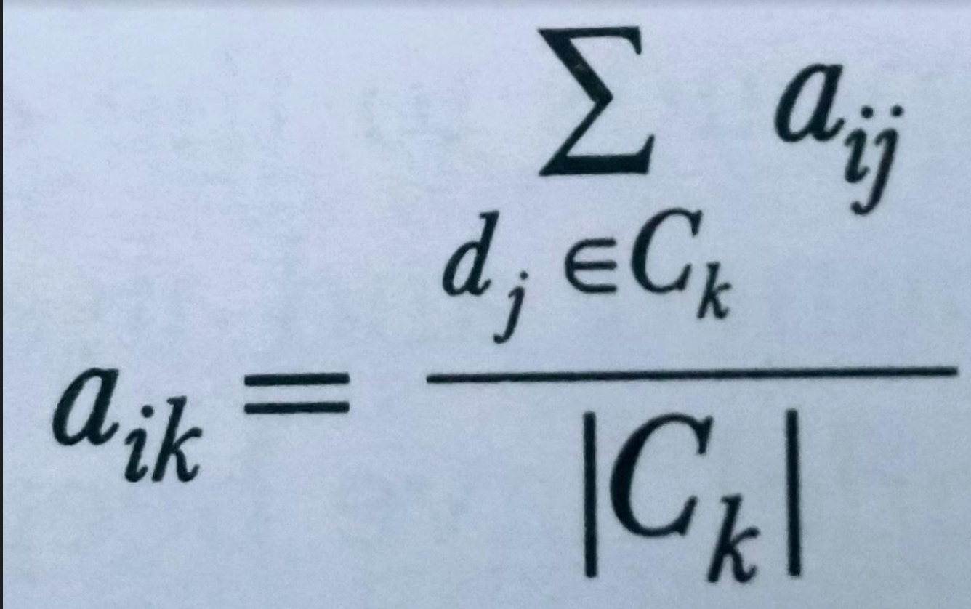
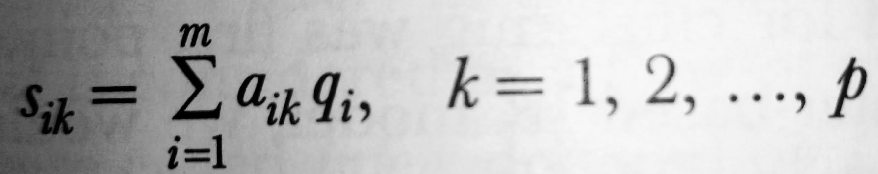
Cluster Model
A representative vector of each cluster is constructed by computing the centroid of the document vectors belonging to that class.
Representation vector for a cluster C_{k} is r_{k} = { a_{1k}, a_{2k}, …, a_{ik}, …, a_{mk} }
An element a_{ik} in this vector is computed as
Where a_{ij} is weight of the term t_{i}, of the document d_{j}, in cluster C_{k}.
During retrieval, the query is compared with the cluster vectors
(r₁, r₂, …, r_{k}, …, r_{p} )
This comparison is carried out by computing the similarity between the query vector q and the representative vector r, as
A cluster C, whose similarity s, exceeds a threshold is returned and the search proceeds in that cluster.

Slide 50
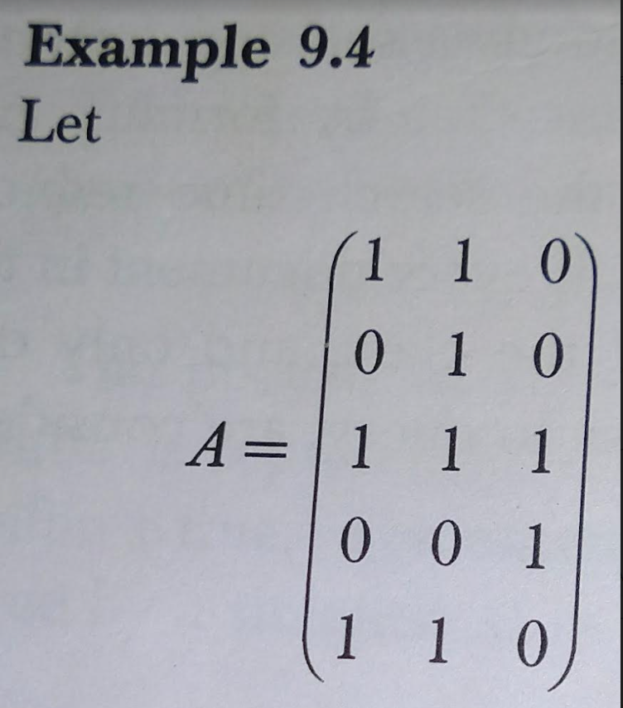
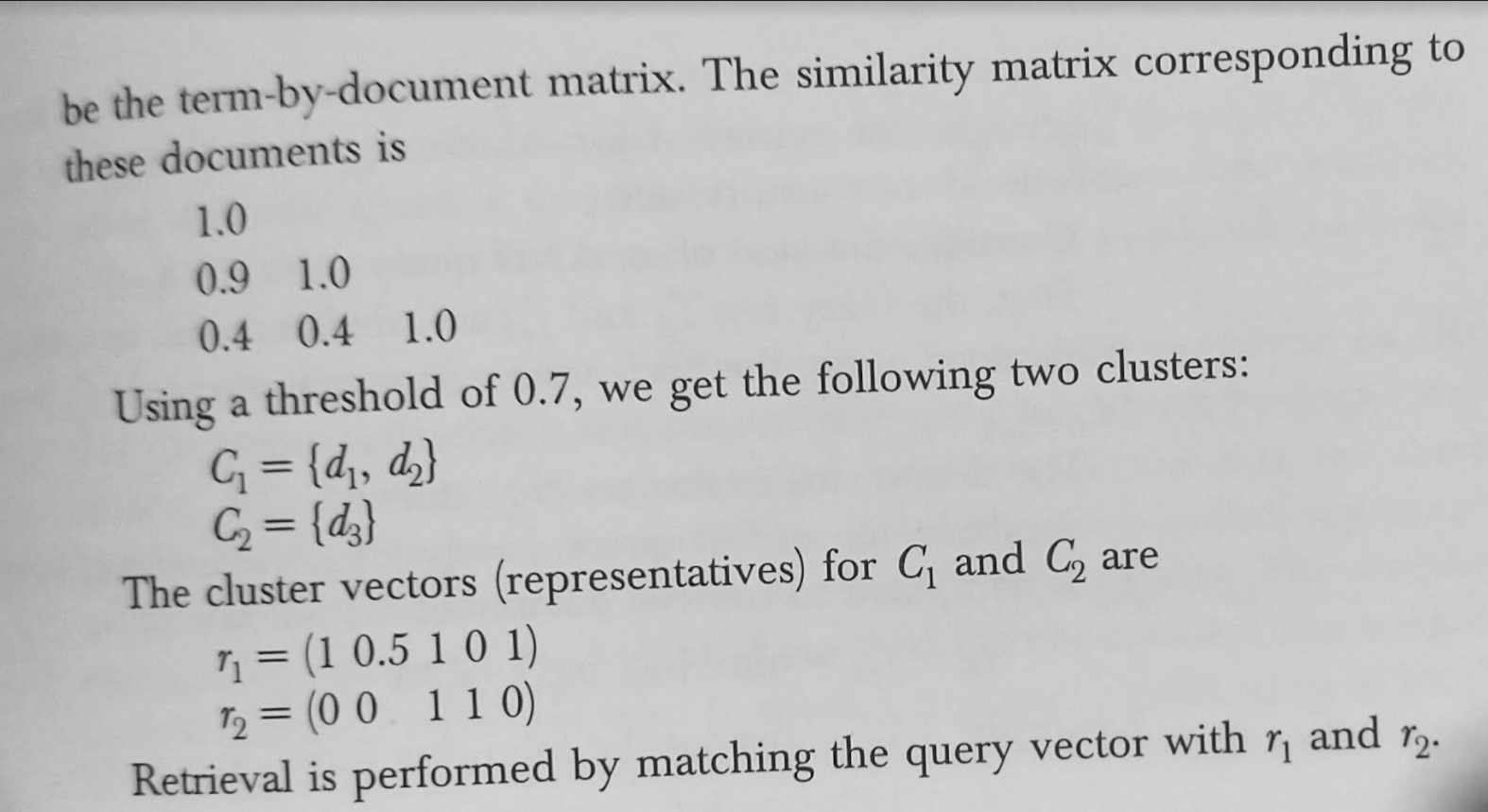
Cluster Model - Example

Slide 51
Fuzzy Model
In the fuzzy model, the document is represented as a fuzzy set of terms, i.e., a set of pairs [ t_{i} ,μ (t_{i} ) ] Where μ is the membership function.
The membership function assigns to each term of the document a numeric membership degree.
The membership degree expresses the significance of term to the information contained in the document.
Significance values (weights) are assigned based on the number of occurrences of the term in the document and in the entire document collection.
Each document in the collection -
D = { d₁, d₂, …, d_{j}, …, d_{n} }
Can thus be represented as a vector of term weights,
(w_{ij}, w_{2j}, w_{3j}, …, w_{ij}, …, w_{mj} ) ^{t}
Where w_{ij} is the degree to which term t_{i} belongs to document d_{j}.

Slide 52
Fuzzy Model
Each term in the document is considered a representative of a subject area and wij is the membership function of document dj to the subject area represented by term ti.
Each term ti is represented by a fuzzy set fi in the domain of documents given by
f_{i} = { (d_{j}, w_{ij}) } | i = 1, …, m; j = 1, …, n
This weighted representation makes it possible to rank the retrieved documents in decreasing order of their relevance to the user’s query.
Queries are Boolean queries.
For each term that appears in the query, a set of documents is retrieved.
Fuzzy set operations are then applied to obtain the desired result.

Slide 53
Fuzzy Model
Single-term Query:
For a single-term query q=t_{q}, those documents from the fuzzy set
f_{q} ={(d_{j}, w_{iq})},
are retrieved for which wiq exceeds a given threshold. The threshold may also be zero.
AND Query:
For an AND query q = t_{q1} ^ t_{q2}, the fuzzy sets fq1 and fq2 are obtained and then, their intersection is obtained, using the fuzzy intersection operator
f_{q1} ^ f_{q2} = min { (d_{j}, w_{iq1}), (d_{j}, w_{iq}) }
The documents in this set are returned.
OR Query:
For an OR query q = t_{q1} V t_{q2}, the union of fuzzy sets fq1 and fa2 is computed to retrieve documents as follows -
f_{q1} V f_{q2} = max { (d_{j}, w_{iq1}), (d_{j}, w_{iq}) }

Slide 54
Fuzzy Model - Example
Consider the following 3 documents:
d₁ = { information, retrieval, query }
d₂ = { retrieval, query, model }
d₃ = { information, retrieval }
Where the set of terms used to represent documents is
T = { information, model, query, retrieval }
Fuzzy set for terms
f₁ = { (d₁, 1/3), (d₂, 0), (d₃, 1/2) } → t₁ = information
f₂ = { (d₁, 0), (d₂, 1/3), ( d₃, 0 ) } → t₂ = model
f₃ = { (d₁, 1/3), (d₂, 1/3), (d₃, 0) } → t₃ = query
f₄ = { (d₁, 1/3), (d₂, 1/3), (d₃, 1/2) } → t₄ = retrieval
If the query is q = t₂ ∧ t₄, then document d₂ is returned.

Slide 55
Latent Semantic Indexing Model
https://www.youtube.com/watch?v=M1duqgg8-IM
https://www.youtube.com/watch?v=P5mlg91as1c
https://www.youtube.com/watch?v=CwBn0voJDaw

Slide 56
Evaluation of IR System
The evaluation of IR systems is the process of assessing how well a system meets the information needs of its users.
IR Evaluation models can be broadly classified as -
system driven - System driven models measure how well a system ranks documents
user-centered models - User-centered models measure user satisfaction.
Following are the six criteria that can be used for evaluation -
Coverage of the collection
Time lag - The time that elapses between submission of a query and getting back the response.
Presentation format
User effort - The effort made by the user to obtain relevant information.
Precision - The proportion of retrieved documents that are relevant.
Recall - The proportion of relevant documents that are retrieved.
Precision and recall are most frequently applied in evaluating IR system and both are related to effectiveness, that is, the ability of a system to retrieve relevant documents in response to user query.

Slide 57
Relevance
Relevance is subjective in nature, it depends on the individual judgements of users.
Given a query, the same document may be judged as relevant by one user and non-relevant by another.
It is not possible to measure true relevance because no human can read all documents in a collection and provide a relevance assessment.
Another issue with relevance is the degree of relevance. Traditionally, relevance is visualized as a binary concept, that is, a document is either relevant or not relevant; whereas relevance is actually a continuous function.
A number of relevance frameworks includes system, communication, psychological and situational frameworks.
The most inclusive of these is the situational framework, which is based on a cognitive view of the information seeking process and considers the importance of situation, context, multi-dimensionality and time.

Slide 58
Effectiveness Measure
Effectiveness is a measure of the ability of a system to satisfy the user in terms of the relevance of documents retrieved.
Aspect of the effectiveness include -
  Whether the documents returned are relevant to the user
  Whether they are presented in order of relevance
  Whether a significant number of relevant documents in the collection are returned to the user.
A number of measures have been proposed to quantify effectiveness. The most commonly used measures of effectiveness are precision and recall.

Slide 59
Precision and Recall
Define precision and recall and explain the tradeoff between them in evaluation of IR systems (8 M, July 2019)
Precision:
Precision is defined as the proportion of relevant documents in a retrieved set.
It is the probability that a relevant document is retrieved.
It measures the accuracy of a system.
Recall:
Recall is the proportion of relevant documents that are actually been retrieved.
Recall measures the exhaustiveness of the system.
Number of relevant documents retrieved ( NR_{ret} )
___________________________________________
Precision =
Total number of documents retrieved ( N_{ret} )
Number of relevant documents retrieved ( NR_{r} )
________________________________________________________
Total number of relevant documents in the collection ( NR_{rel} )
Recall =

Slide 60
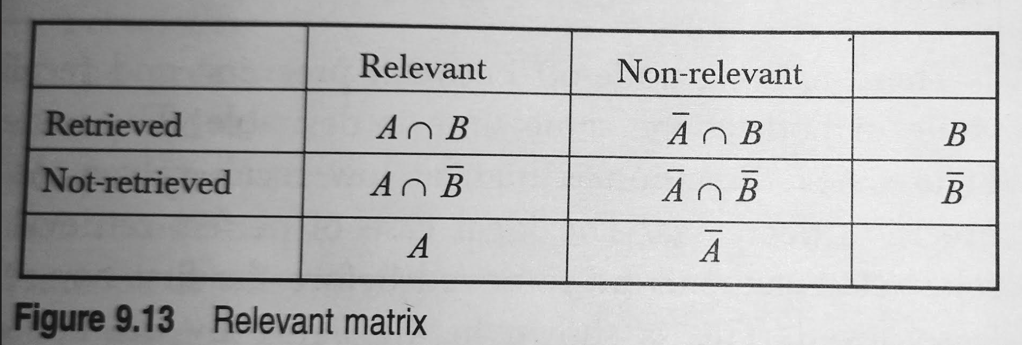
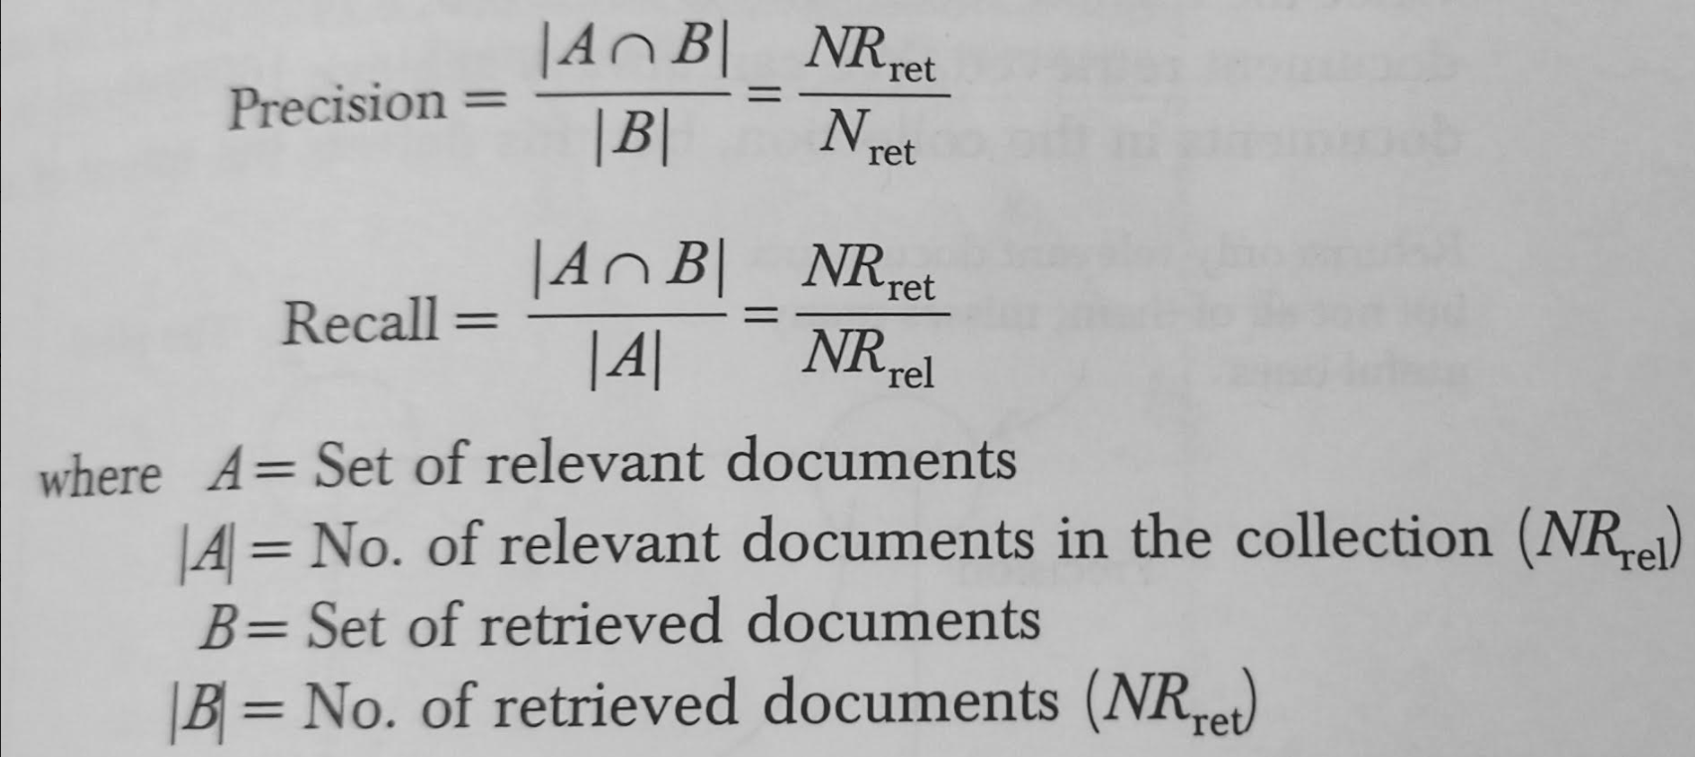
Precision and Recall
Precision and recall are based on binary relevance judgement.
Every retrievable item is recognizably ‘relevant’, or recognizably ‘not relevant’.
For every search result, all retrievable documents will be either -
  Relevant or non-relevant
  Retrieved or not retrieved
Hence, each document will fall into one, and only one, of four cells of the matrix as shown in relevant matrix

Slide 61
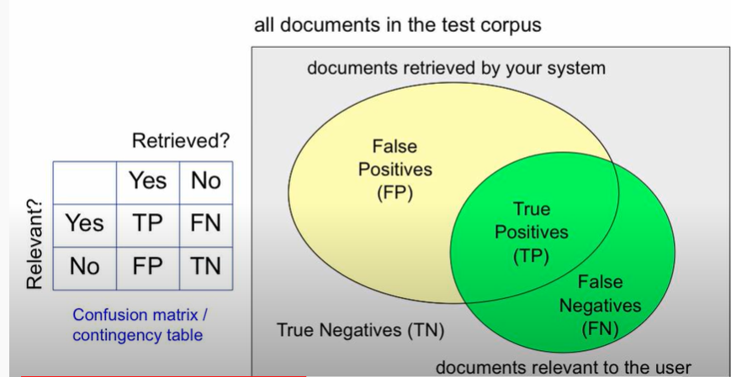
Precision and Recall
Refer: https://www.youtube.com/watch?v=mctizdBujk4

Slide 62
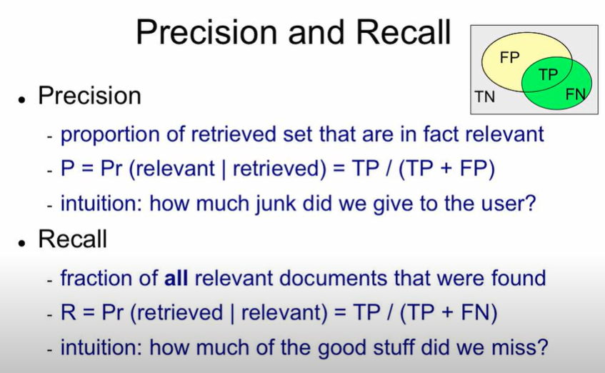
Precision and Recall

Slide 63
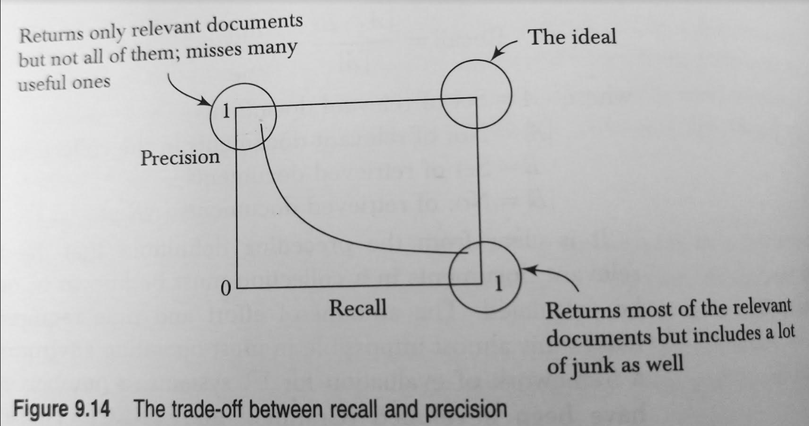
Trade off between precision and recall
There exists a tradeoff between precision and recall, though a high value of both at the same time is desirable.
Precision is high at low recall values.
As the recall increases, precision decreases.
The ideal case of perfect retrieval requires that all relevant documents be retrieved before the first non-relevant document is retrieved.
This is shown in the figure by the line parallel to x-axis having a precision of 1.0 at all recall points.
Recall is an additive process. Once the highest recall (1.0) is achieved, it remains 1.0 for any subsequent document retrieved.
We can achieve 100% recall by retrieving all documents in the collection, but this defeats the intent of the IR system.
A multi-stage retrieval is used to improve both recall and precision simultaneously. Precision is calculated at a particular cut-off, typically 5 documents, 10 documents, 15 documents, etc.
Another measure called, non-interpolated average precision

Slide 64
Non-interpolated Average Precision
Non-interpolated average precision is the average precision at observed recall points.
Observed recall points correspond to points where a relevant document is retrieved.
First, compute precision at each point where a relevant document is found and then compute average of these precision numbers to get a single number.

Slide 65
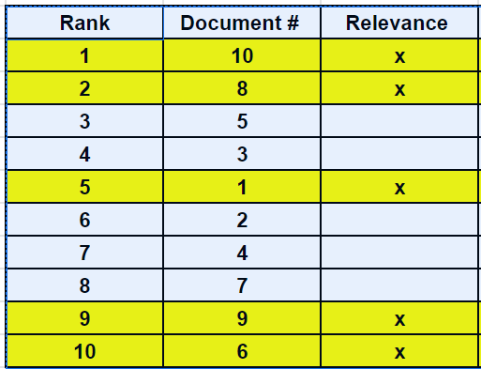
Example: To compute Non-interpolated Average Precision
The table shows the ranking of 10 documents for a particular retrieval. The crossed documents are those that are relevant. Find the non-interpolated average precision.

Slide 66
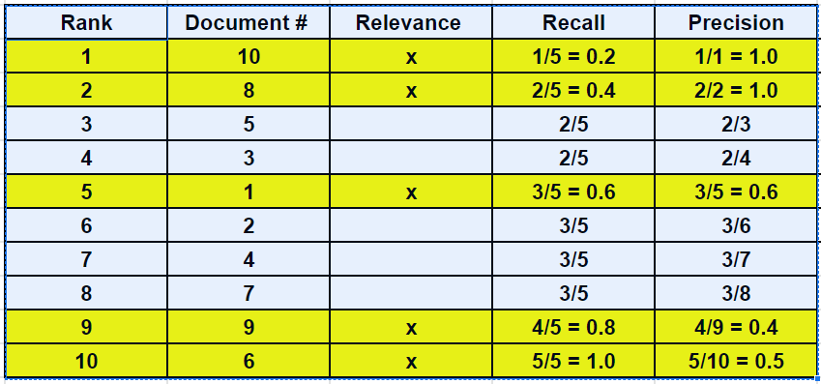

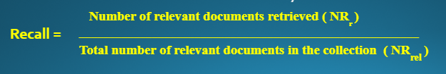
Example to compute Non-interpolated Average Precision

Slide 67
Example to compute Non-interpolated Average Precision
Observed recall points correspond to points where a relevant document is retrieved. The observed recall points are 0.2, 0.4, 0.6, 0.8 and 1.0
Precision at recall point 0.2: 1/1 = 1.0
Precision at recall point 0.4: 2/2 = 1.0
Precision at recall point 0.6: 3/5 = 0.6
Precision at recall point 0.8: 4/9 = 0.4
Precision at recall point 1.0: 5/10 = 0.5
Non-interpolated average precision = 1.0 + 1.0 + 0.6 + 0.4 + 0.5 = 0.7
5

Slide 68
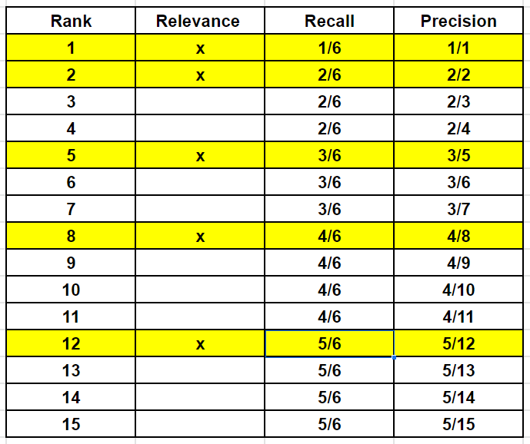
Example to compute Non-interpolated Average Precision
A user submitted a query to an IR system, out of the first 15 documents returned by the system, those ranked 1, 2, 5, 8, 12 were relevant. Compute the non-interpolated average precision of this retrieval. Assume there are 6 relevant documents. (6 M, Jan 2020)
Observed Recall Points are
1/6 = 0.17
2/6 = 0.11
3/6 = 0.5
4/6 = 0.67
5/6 = 0.83
Precision at recall point 0.17 = 1.0
Precision at recall point 0.11 = 1.0
Precision at recall point 0.5 = 0.6
Precision at recall point 0.67 = 0.5
Precision at recall point 0.83 = 0.42
Non-interpolated Average Precision = 1.0 + 1.0 + 0.6 + 0.5 + 0.42 = 3.52
5 5
Non-interpolated Average Precision = 0.704

Slide 69
Lexical Resources
Write short notes on WordNet, FrameNet, Stemmer, POS Tagging (16 M, Feb 2021)
Various tools and lexical resources are developed to ease the task of researchers working with NLP.
These resources are open sources and are readily available.
The various resources and tools are
Lexical Resources
  WordNet
  FrameNet
Tools
  Stemmers
  Taggers
  Parsers
  Freely Available test corpuses for text-processing applications

Slide 70
WORDNET
Explain WordNet. List the applications of WordNet (6 M, Jan 2020)
Explain WordNet and list the applications of WordNet (10M, Feb 2021)
Write a note of WordNet Lexical Resource and its application in NLP (6M, July 2019)
Explain the WordNet for English language and its applications. (8M, Jan 2019)
WordNet is a large lexical database for the English language.
Inspired by psycholinguistic theories, it was developed and is being maintained at the Cognitive Science Laboratory, Princeton University, under the direction of George A. Miller.
WordNet consists of three databases
  One for nouns
  One for verbs
  One for both adjectives and adverbs
Information is organized into sets of synonymous words called synsets, each representing one base concept.
The synsets are linked to each other by means of lexical and semantic relations.

Slide 71
WORDNET
Lexical relations occur between word-forms (senses) and semantic relations between word meanings.
These relations include synonymy, hypernymy / hyponymy, antonymy, meronymy / holonymy, troponymy, etc.
A word may appear in more than one synset and in more than one part-of-speech. The meaning of the word is called sense.
WordNet lists all senses of a word, each sense belonging to a different synset.
WordNet’s sense-entries consist of a set synonyms and a gloss.

Slide 72
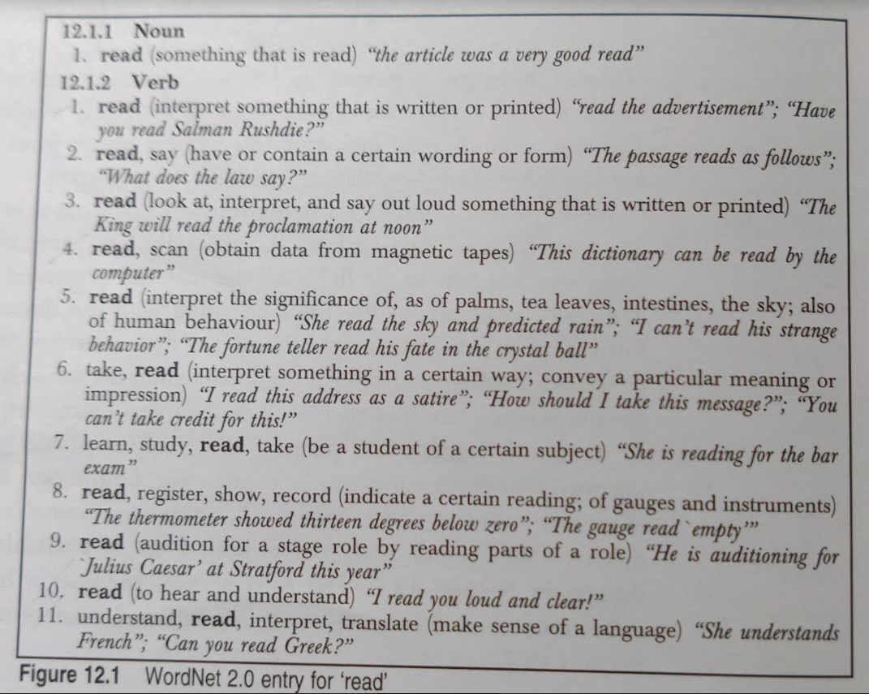
WORDNET
A gloss consists of a dictionary-style definition and examples demonstrating the use of a synset in a sentence, as shown in the figure below.

Slide 73
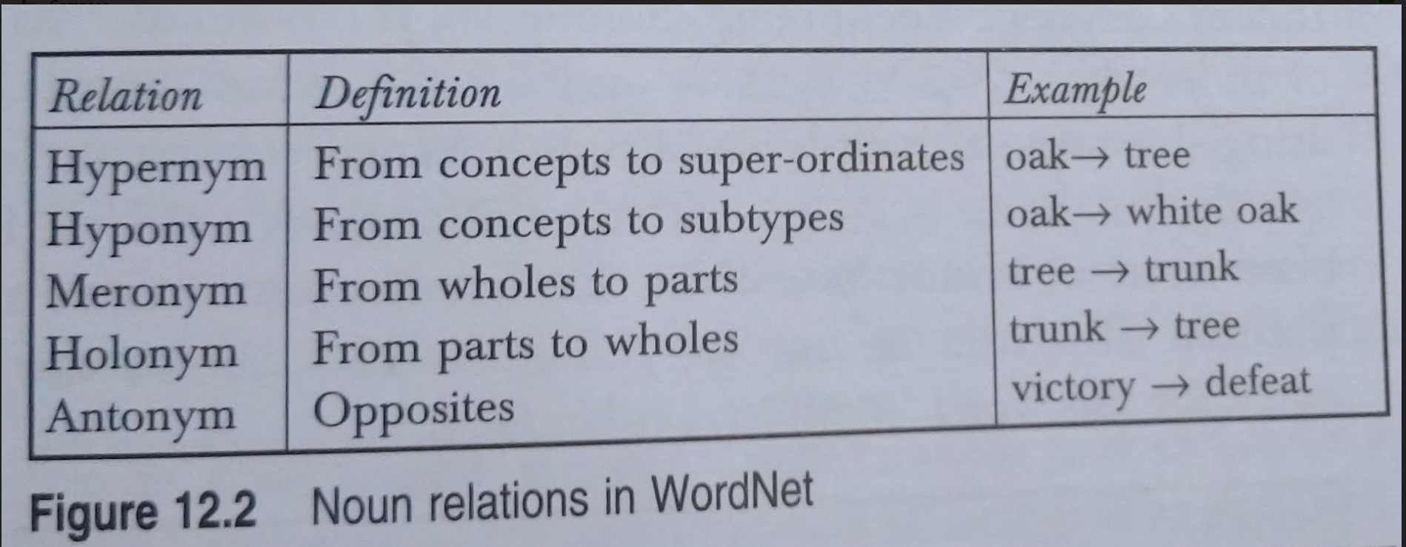
WORDNET
Write the hypernym chain for ‘RIVER’ extracted from WordNet 2.0 (4M, Jan 2020)
The figure shows the entries for the word ‘read’. Read has one sense as a noun and 11 senses as a verb.
Glosses help differentiate meanings.
Figure show Noun relations in WordNet
Nouns and verbs are organized into hierarchies based on the hypernymy / hyponymy relation.
Notes:
Hypernym - a word with a broad meaning constituting a category into which words with more specific meanings fall; a superordinate. For example, colour is a hypernym of red.

Slide 74
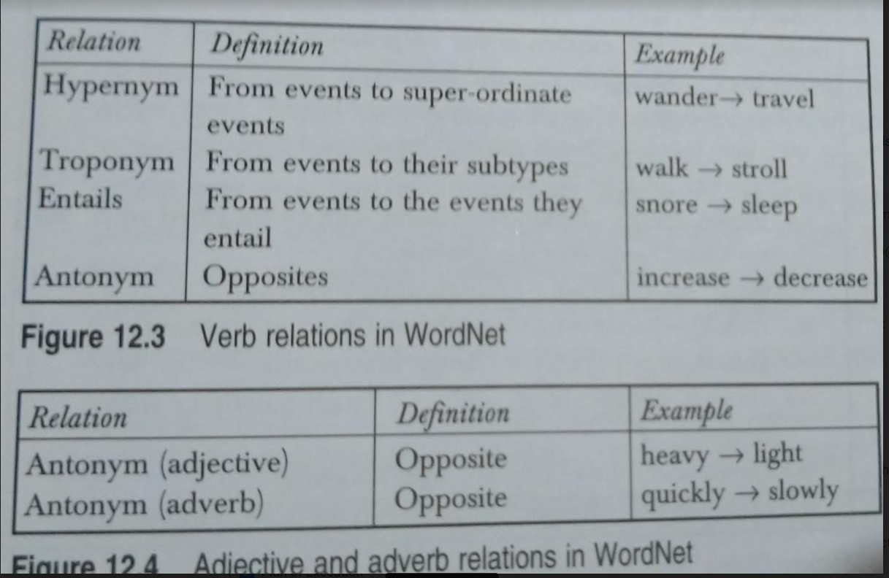
WORDNET
Figure shows the verb, adjective and adverb relations in Wordnet
Notes:
Hypernym - a word with a broad meaning constituting a category into which words with more specific meanings fall; a superordinate. For example, colour is a hypernym of red.

Slide 75
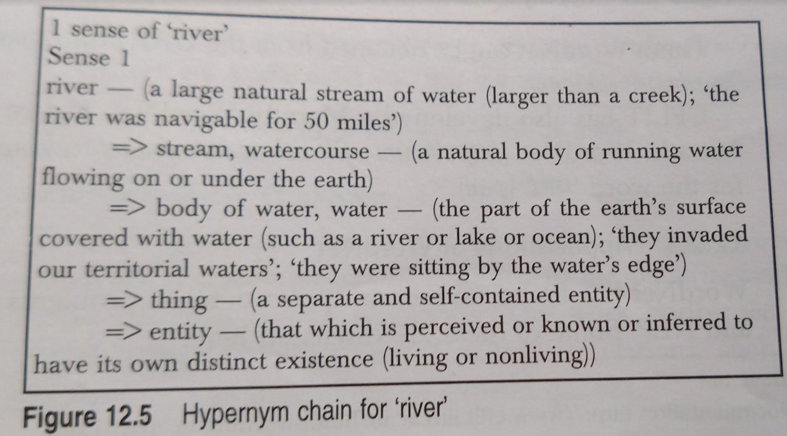
WORDNET
Write the hypernym chain for ‘RIVER’ extracted from WordNet 2.0 (4M, Jan 2020)
The below figure shows the hypernym chain for ‘RIVER’ extracted from WordNet.
Notes:
Hypernym - a word with a broad meaning constituting a category into which words with more specific meanings fall; a superordinate. For example, colour is a hypernym of red.

Slide 76
WORDNET
WordNet is freely and publicly available for download from http://wordnet.princeton.edu/obtain
WordNet for other languages have been developed, Example, EuroWordNet and Hindi WordNet
EuroWordNet covers European languages, including English, Dutch, Spanish, Italian, German, French, Czech, and Estonian.
Hindi WordNet has been developed by CFILT (Resource Center for Indian Language Technology Solutions), IIT Bombay. Its database consists of more than 26208 synsets and 56928 Hindi words. It is organized using the same principles as English WordNet but include some Hindi specific relations - causative relations.
Hindi WordNet can be obtained from the URL http://www.cfilt.iitb.ac.in/wordnet/webhwn/
CFLIT has also developed a Marathi WordNet http://www.cfilt.iitb.ac.in/wordnet/webmwn/wn.php

Slide 77
Application of WORDNET
Concept identifications in Natural language
  WordNet can be used to identify concepts pertaining to a term, to suit them to the full semantic richness.
Word sense disambiguation
  It offers
    sense definitions of words
    identifies synsets of synonyms
    Defines a number of semantic relations
Automatic Query Expansion
  WordNet semantic relations can be used to expand queries so that the search for a document is not confined to the pattern-matching of query terms, but also covers synonyms.
Document structuring and categorization
  The semantic information extracted from WordNet have been used for text categorization.
Document summarization
  The approach presented by Barzilay and Elhadad uses information from WordNet to compute lexical chains.

Slide 78
FRAMENET
FrameNet is a large database of semantically annotated English sentences.
It is based on principles of frame semantics.
It defines a tagset of semantic roles called the frame element.
Sentences from the British National Corpus are tagged with these frame elements.
The basic philosophy involved is that each word evokes a particular situation with particular participants.
FrameNet aims at capturing these situations through case-frame representation of words (verbs, adjectives, and nouns).
The word that invokes a frame is called target word or predicate, and the participant entities are defined using semantic roles, which are called frame elements.
The FrameNet ontology can be viewed as a semantic level representation of predicate argument structure.

Slide 79
FRAMENET
Each frame contains a main lexical item as predicate and associated frame-specific semantic roles, such as AUTHORITIES, TIME, AND SUSPECT in the ARREST frame, called frame elements.
Example: The sentence below is annotated with semantic roles AUTHORITIES AND SUSPECT
  [_{Authorities} The police] nabbed [_{suspect} the snatcher].
The COMMUNICATION frame has the semantic roles ADDRESSEE, COMMUNICATOR, TOPIC, and MEDIUM.
A JUDGEMENT frame contains roles such as a JUDGE, EVALUEE, and REASON.
Example:
  [_{judge} She] [_{Evaluee} blames the police] [ _{Reason} for failing to provide enough protection].
A frame may inherit roles from another frame. Eg., a STATEMENT frame may inherit from a COMMUNICATION frame, it contains roles such as SPEAKER, ADDRESSEE, and MESSAGE.
Example:
  [_{Speaker} She] told [_{Addressee} me] [_{Message} ‘I’ll return by 7:00 pm today’].

Slide 80
FrameNet APPLICATIONS
FrameNet data can be used for
  Automatic semantic parsing
  Information extraction
  Question answering system
  Information retrieval
  Machine translation
  Text summarization
  Word sense disambiguation

Slide 81
STEMMERS
Stemming or conflation is the process of reducing inflected words to their base or root form.
The stem need not be identical to the morphological base of the word.
It is sufficient if related words map to the same stem, even if the stem is not in itself a valid root.
Stemming is useful in search engines for query expansion or indexing.
Stemming programs are commonly referred to as stemmers.
The most common algorithm for stemming English is Porter’s algorithm, other stemmers are Lovins stemmer and Paice/Husk stemmer.

Slide 82
STEMMERS
Stemmers for European Languages:
  Snowball presents stemmers for English, Russian and a number of other European languages, including French, Spanish, Portuguese, Hungarian, Italian, German, Dutch, Swedish, Norwegian, Danish and Finnish.
Stemmers for Indian Languages:
  The Resource Centre of Indian Language Technology (CFILT), IIT Bombay has developed stemmers for Indian languages, which are available at http://www.cfilt.iitb.ac.in
Stemming Application:
  Stemmers are used in
    Web search engines
    Text summarization
    Text categorization

Slide 83
PART-OF-SPEECH TAGGER
Part-of-Speech tagging is used at an early stage of text processing in many NLP application such as
  Speech synthesis
  Machine translation
  Information Retrieval
  Information extraction

Slide 84
PART-OF-SPEECH TAGGER
Various part-of-speech taggers are -
  Stanford Log-linear Part-of Speech (POS) Tagger
  Part-of-Speech Tagger for English
  TnT Tagger
  Brill Tagger
  CLAWS Part-of-Speech Tagger for English
  Tree-Tagger
  ACOPOST - A Collection of POS Taggers
    Maximum Entropy Tagger (MET)
    Trigram Tagger (T3)
    Error-driven Transformation-based Tagger (TBT)
    Example-based Tagger (ET)

Slide 85
RESEARCH CORPORA
Research carpora is developed for a number of NLP related tasks.
Following are the available standard document collections -
  IR Test Collection
  Summarization Data
  Word Sense Disambiguation
  Asian Language Corpora

